Slide 1







Your Healthcare Presentation
MEDICAL DATA HISTORY
PROJECT ID : PRSQL-02
Submitted By:
ANUPAMA SHARMA
Project Team Id: PTID-CDA-MAY-25-464

Slide 2



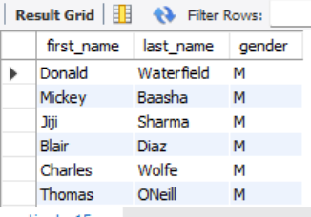
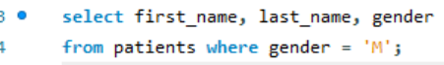

TASK 1 : Show first name, last name, and gender of patients who’s gender is ‘M’.
2468 records pulled.
Data pulled from patients table.

Slide 3

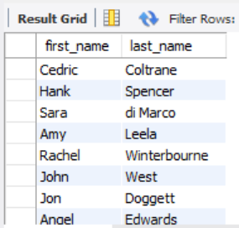
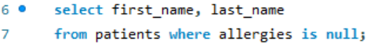
TASK 2 : Show first name and last name of patients who does not have allergies.
2059 records pulled.
‘is null’ command is used to get the result
where patients does not have any allergies.
.

Slide 4
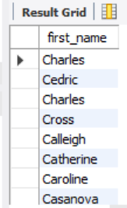
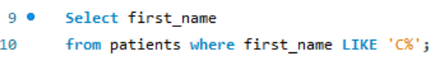
TASK 3 : Show first name of patients that start with the letter 'C’.
302 records pulled from data.
‘LIKE’ command used to get desired result.
.

Slide 5



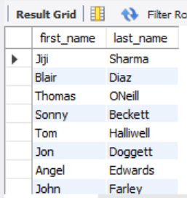

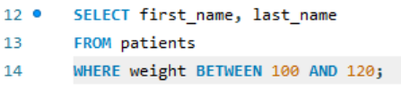


TASK 4 : Show first name and last name of patients that weight within the range of 100 to 120.
952 records pulled.
‘Between’ and ‘and’ command is used.
02
OUR PROJECTS

Slide 6
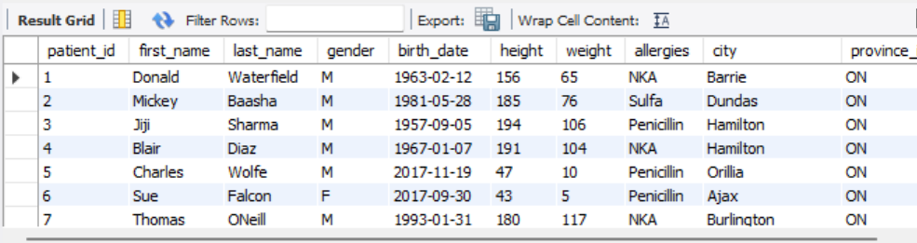
TASK 5 :Update the patients table for the allergies column. If the patient's allergies is null then replace it with 'NKA’.
Used the coalesce( ) to replace NULL values in the allergies column with the placeholder “NKA” without modifying the table. Because UPDATE command denied by the user.
02
OUR PROJECTS

Slide 7
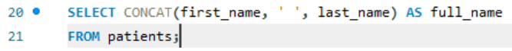
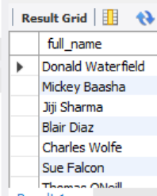
TASK 6 : Show first name and last name concatenated into one column to show their full name.
CONCAT ( ) function is used to merge and show the full name.
.

Slide 8
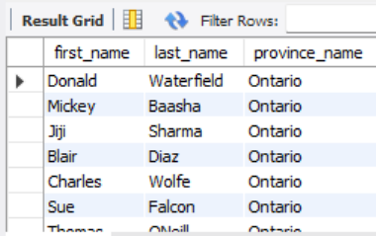
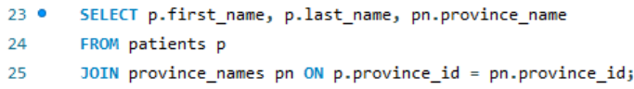
TASK 7 : Show first name, last name, and the full province name of each patient.
Display each patient’s first name, last name, and full province name.
INNER JOIN for combining data from two related tables.
.

Slide 9
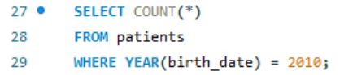
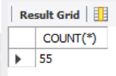
TASK 8: Show how many patients have a birth_date with 2010 as the birth year.
Count of 55 patients found.
COUNT command is used to get desired results.
.

Slide 10
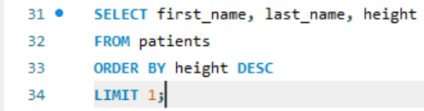
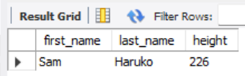
TASK 9: Show the first_name, last_name, and height of the patient with the greatest height.
Sort the patients table by height in descending order.
Return the topmost record (tallest patient) using LIMIT 1.
02
OUR PROJECTS

Slide 11
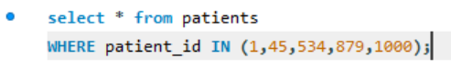
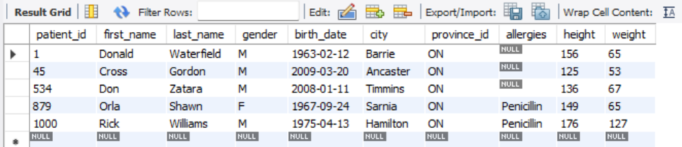
TASK 10 : Show all columns for patients who have one of the following patient_ids: 1,45,534,879,1000.
‘WHERE’ and ‘IN’ commands is used to get desired results of specific patient ids.
02
OUR PROJECTS

Slide 12

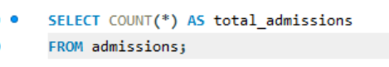
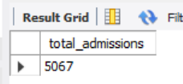
TASK 11 : Show the total number of admissions.
Count of 5067 total admissions.

Slide 13
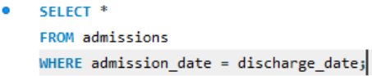
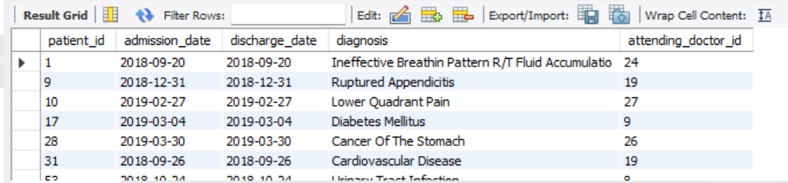
TASK 12 : Show all the columns from admissions where the patient was admitted and discharged on the same day.
481 records pulled
‘WHERE’ command is used to get the desired result.

Slide 14



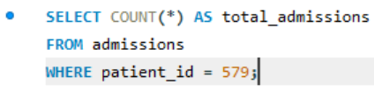
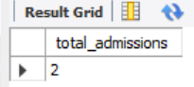


TASK 13 : Show the total number of admissions for patient_id 579.
Count of 2 admissions pulled.
‘WHERE’ command is used to get number of total admissions of desired patient.
]

Slide 15
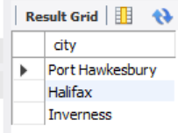
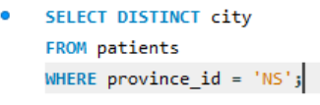
TASK 14 : Based on the cities that our patients live in, show unique cities that are in province_id 'NS’?
3 records pulled.
‘DISTINCT’ and ‘WHERE’ command is used to get desired results
]

Slide 16
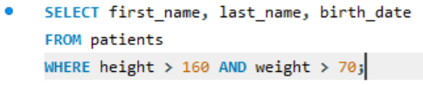
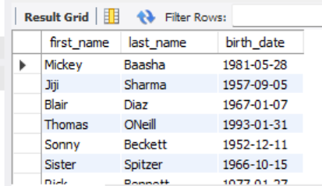
TASK 15 : Write a query to find the first_name, last name and birth date of patients who have height more than 160 and weight more than 70.
2091 records pulled from data.
‘WHERE’ and ‘AND‘ command is used to get desired results.
]

Slide 17
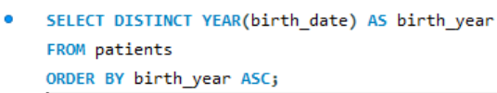
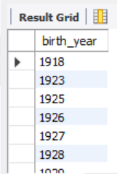
TASK 16 :. Show unique birth years from patients and order them by ascending.
93 unique birth year records polled from data
]

Slide 18




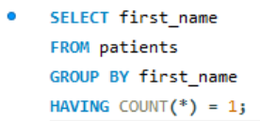
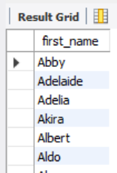

TASK 17 : Show unique first names from the patients table which only occurs once in the list.
Gives unique first names that appear only once in the dataset
Used ‘GROUP BY’ and ‘HAVING’ to filter names with exactly one occurrence.

Slide 19
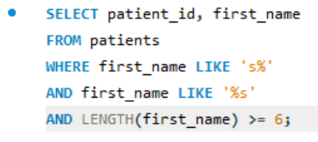
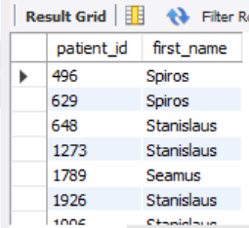
TASK 18 : . Show patient_id and first_name from patients where their first_name start and ends with 's' and is at least 6 characters long.
11 records of data pulled which starts and ends with ‘s’.
‘LIKE’ and LENGTH() function used to get desired results.

Slide 20
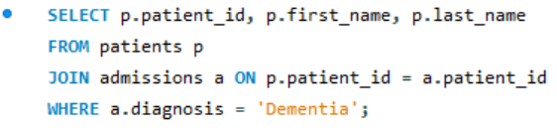
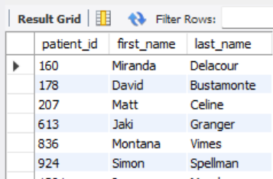
TASK 19 : Show patient_id, first_name, last_name from patients who’s diagnosis is 'Dementia'. Primary diagnosis is stored in the admissions table.
JOINS patients and admissions tables.
Returns patients who were diagnosed with 'Dementia'.

Slide 21
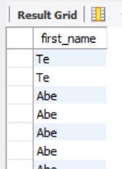
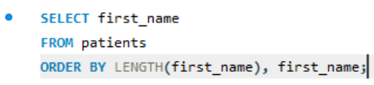
TASK 20 : . Display every patient's first_name. Order the list by the length of each name and then by alphabetically.
Returns all patient’s first name.
Orders them by length first, then alphabetically for equal-length names.

Slide 22
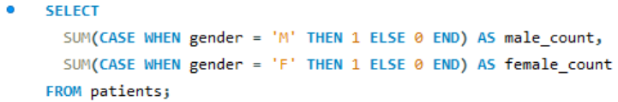
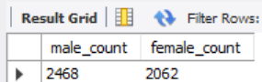
TASK 21 : Show the total amount of male patients and the total amount of female patients in the patients table. Display the two results in the same row.
Counts total male and female patients using CASE within SUM().

Slide 23
TASK 22 : Show the total amount of male patients and the total amount of female patients in the patients table. Display the two results in the same row.
Counts total male and female patients using CASE within SUM().

Slide 24



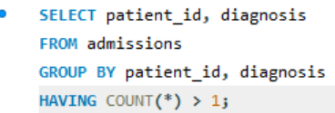
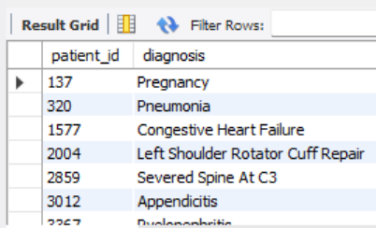
TASK 23 : Show patient_id, diagnosis from admissions. Find patients admitted multiple times for the same diagnosis.
11 records of data pulled.
‘GROUP BY’, ‘HAVING’ and ‘COUNT’ command used to get desired result.

Slide 25
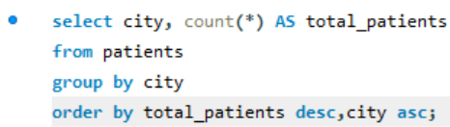
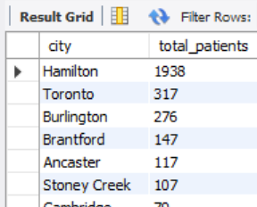
TASK 24 : Show the city and the total number of patients in the city. Order from most to least patients and then by city name ascending.
‘COUNT’ is used to count total patients.
‘GROUP BY’ and ‘Order BY’ is used to sort the patients from most to least then by city name.

Slide 26
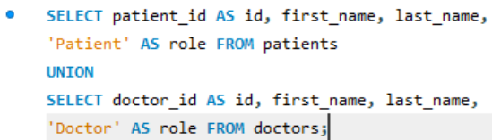
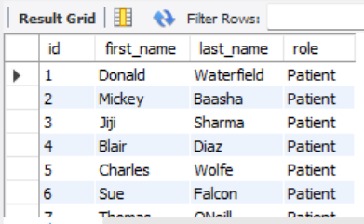
TASK 25 : Show first name, last name and role of every person that is either patient or doctor. The roles are either "Patient" or "Doctor“.
Combines patients and doctors with ‘UNION’.
Adds a role column to indicate whether the person is a patient or doctor.

Slide 27


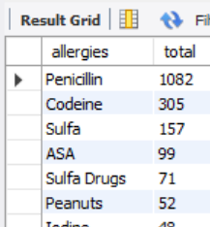
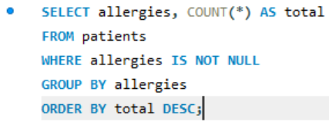


TASK 26 : Show all allergies ordered by popularity. Remove NULL values from query.
Returns each allergy and how many patients have it.
‘GROUP BY’ and ‘ORDER BY’ used to get the desired result and ‘DESC’ is used to sort the results according to popularity.
MONTHLY

Slide 28
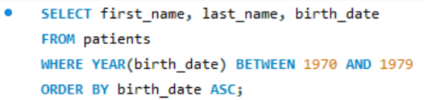

TASK 27 : Show all patient's first_name, last_name, and birth_date who were born in the 1970s decade. Sort the list starting from the earliest birth_date.
Returns patients born in the 1970s and used ‘DESC’ sort from the earliest.
‘WHERE’ and “BETWEEN’ is used to get desired result.
MONTHLY

Slide 29


TASK 28 : We want to display each patient’s full name in a single column. Their last_name in all upper letters must appear first, then first_name in all lowercase letters. Separate the last_name and first_name with a comma. Order the list by the first_name in descending order.
‘CONCAT’,’UPPER’ and ‘LOWER’ is used to display last_name and first_name as full name.
‘ORDER BY’ and ‘DESC’ is used to sort the result.
MONTHLY

Slide 30


TASK 29 : Show the province_id(s), sum of height; where the total sum of its patient's height is greater than or equal to 7,000.
Returns provinces where the total height of all patients is at least 7000 cm.
Used ‘GROUP BY’ and ‘HAVING’ on aggregate data.
MONTHLY

Slide 31


TASK 30 : Show the difference between the largest weight and smallest weight for patients with the last name 'Maroni’.
‘MAX’ and ‘MIN’ used to calculate difference between the heaviest and lightest patient with last name 'Maroni'.
MONTHLY

Slide 32




TASK 31 : Show all of the days of the month (1-31) and how many admission_dates occurred on that day. Sort by the day with most admissions to least admissions.
‘COUNT’ command calculate total admissions occurred on each day .
‘ORDER BY’ and ‘GROUP BY’ used to sort from most to least admissions.

Slide 33


TASK 32 : Show all of the patients grouped into weight groups. Show the total amount of patients in each weight group. Order the list by the weight group descending.
Groups patients into weight groups (e.g., 100–109, 110–119).
‘ORDER BY’ weight groups from highest to lowest.

Slide 34




TASK 33 : Show patient_id, weight, height, isObese from the patients table. Display is Obese as a Boolean 0 or 1.
Calculates BMI for each patient.
Flags them as isObese = 1 if BMI ≥ 30, else 0.

Slide 35


.
TASK 34 : Show patient_id, first_name, last_name, and attending doctor's specialty. Show only the patients who has a diagnosis as 'Epilepsy' and the doctor's first name is 'Lisa'. Check patients, admissions, and doctors tables for required information.
Shows epilepsy patients treated by a doctor named 'Lisa’.
Returns doctor specialty too.

Slide 36


.
TASK 35 : All patients who have gone through admissions, can see their medical documents on our site. Those patients are given a temporary password after their first admission. Show the patient_id and temp_password.
This query generates temporary passwords only for patients who have at least one admission record. It intentionally excludes patients who were never admitted

Slide 37

THANK YOU

